Slide 1
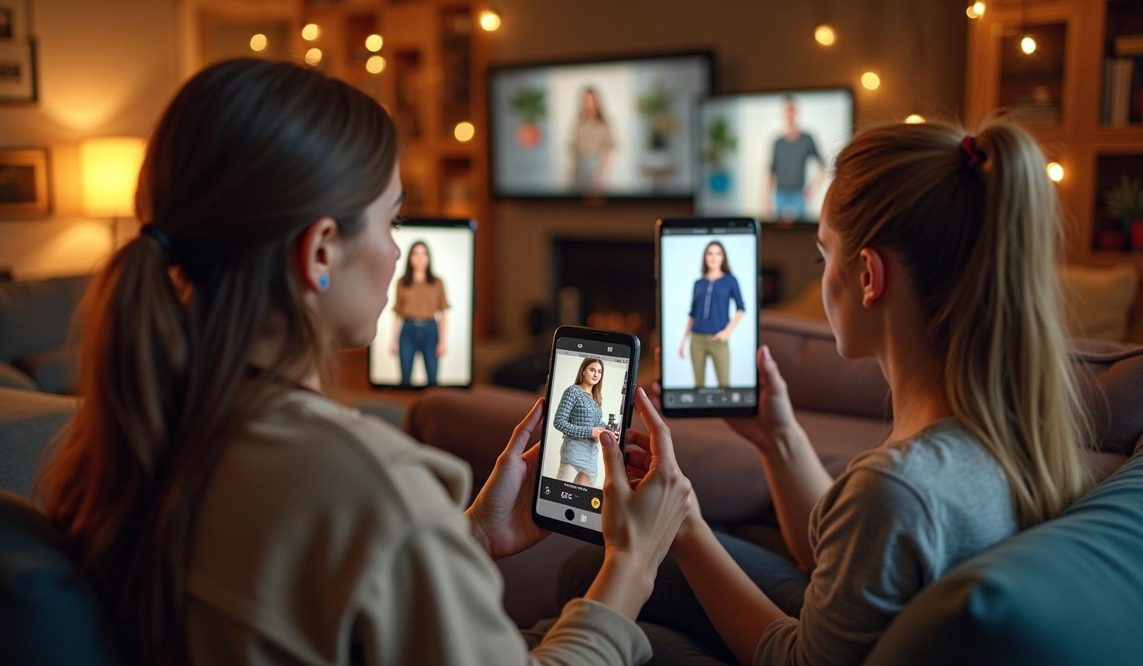
Try & Buy

Slide 2


Introduction
In recent years, online shopping has become more popular than ever. However, one major drawback remains: customers cannot try on clothes before purchasing. This often leads to uncertainty, dissatisfaction, and a high return rate.
To solve this problem, we developed a Virtual Try-On system for e-commerce platforms. This system allows users to upload a photo of themselves and see how clothes would look on them — virtually — before making a purchase.
Our goal is to enhance the online shopping experience by making it more interactive, personalized, and confidence-boosting for customers. By using the power of machine learning and computer vision, we aim to bridge the gap between traditional in-store shopping and the convenience of buying online.

Slide 3
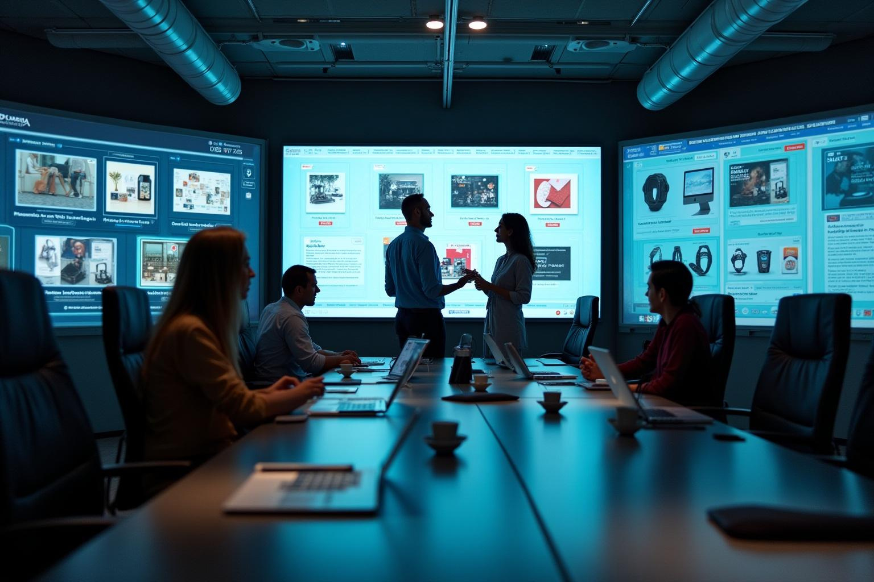
Overview
01

Slide 4
Frontend Interface
A user-friendly interface where customers can upload their photo and choose clothes from a catalog.
Displays the final try-on image in an interactive way.

Slide 5
Backend System
Developed using Spring Boot, the backend handles user authentication, manages the product catalog, stores user data, and communicates with the ML model.
REST APIs are used to connect the frontend with the backend logic.

Slide 6
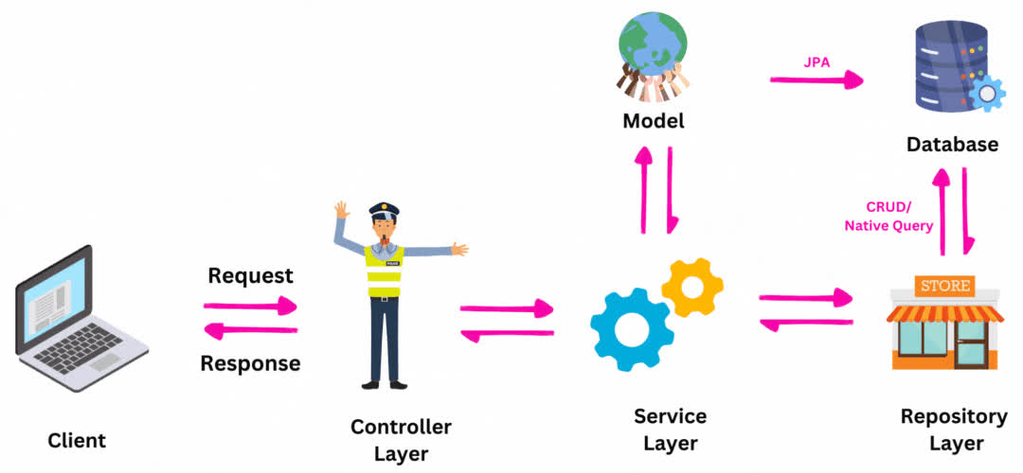
MVC

Slide 7
Machine Learning Module
Processes the input image and selected clothing.
Generates an output image where the selected outfit is realistically overlaid on the user.
Uses models inspired by VITON or other deep learning architectures.

Slide 8
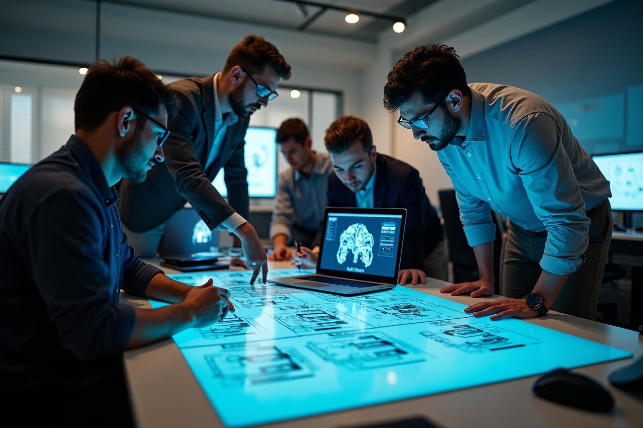
02
Diagrams

Slide 9

Functional & Nonfunctional

Slide 10

Type Functional Requirement
User Registration
User Login
Product Search
Cart Management
Place orders.
Cancel orders.
View their past orders.
Account Management ( edit account information)
Contact Us
Logout
Try-On
User

Slide 11
Admin
Product Management (Admin)
Add new products.
View products.
Update product details.
Delete products.
View Messages

Slide 12
Non-Functional Requirement
Performance
Scalability
Usability
Security
Authorization
Availability
Maintainability
Compatibility
Data Integrity

Slide 13
FlowChart

Slide 14
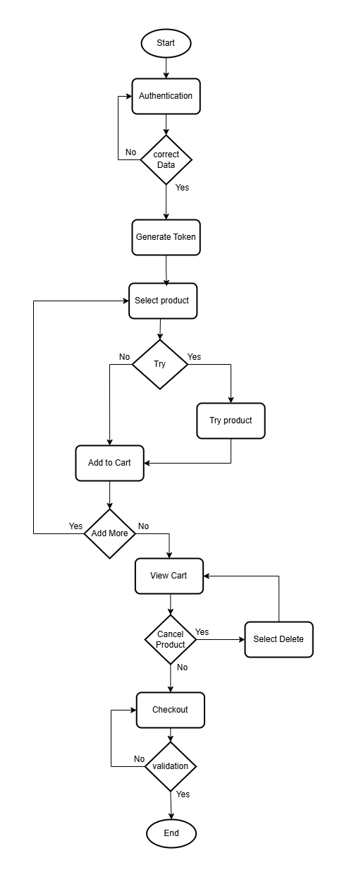

Slide 15
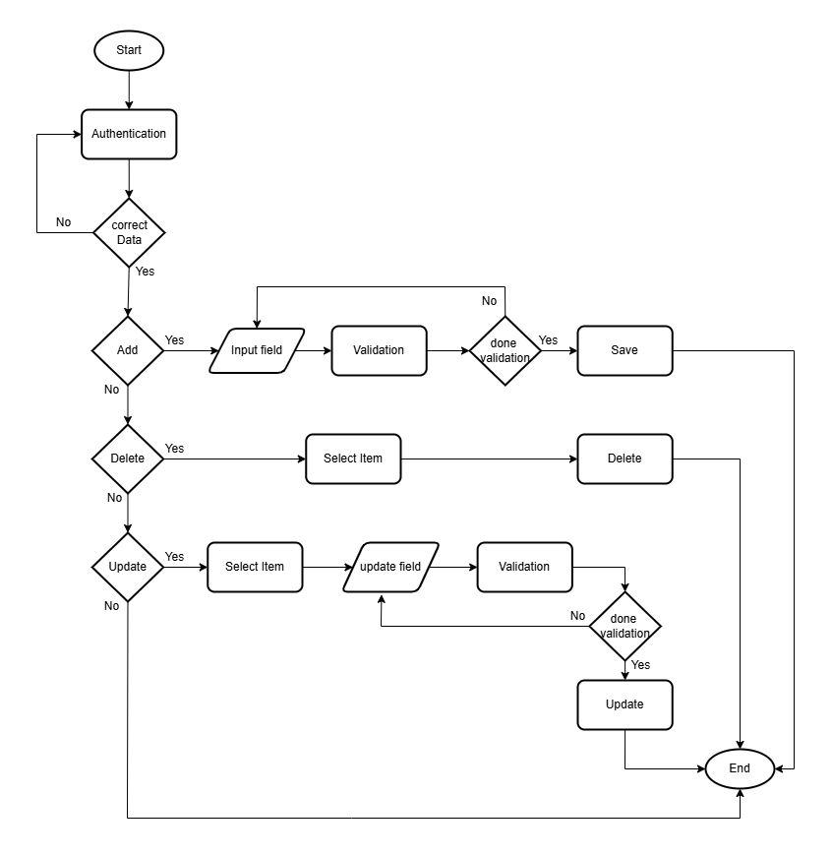

Slide 16
Sequence

Slide 17
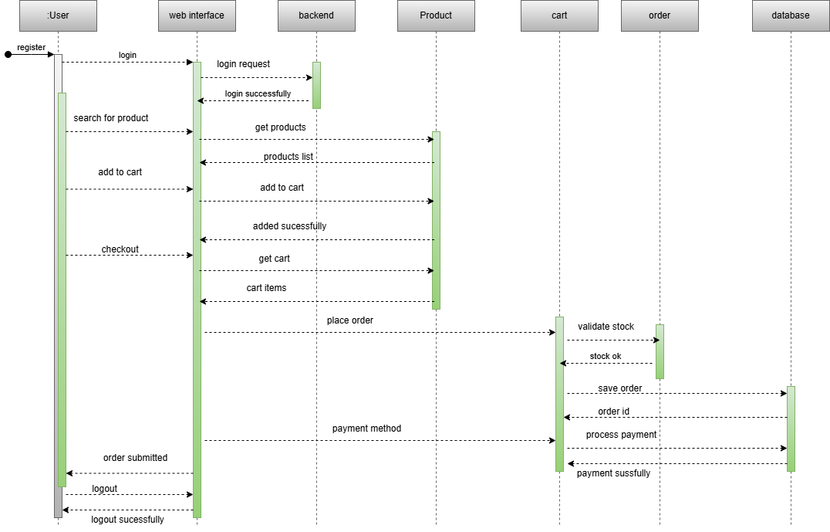

Slide 18
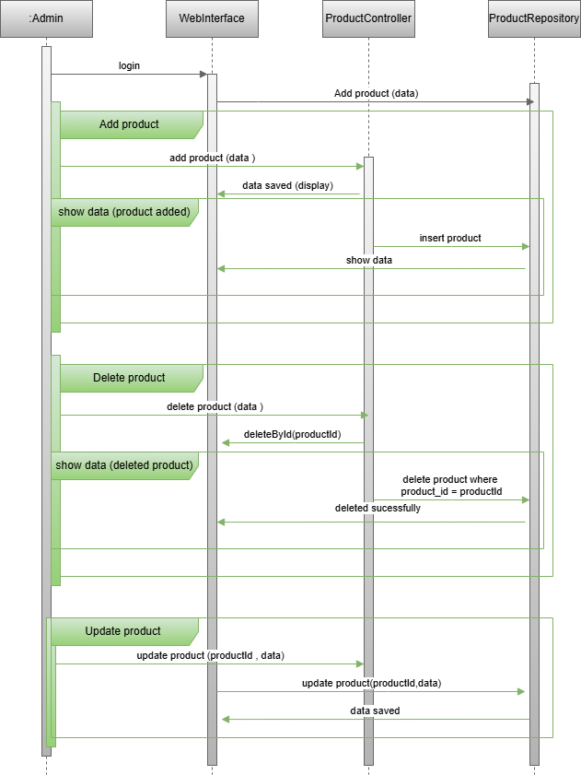

Slide 19
Class Diagram

Slide 20
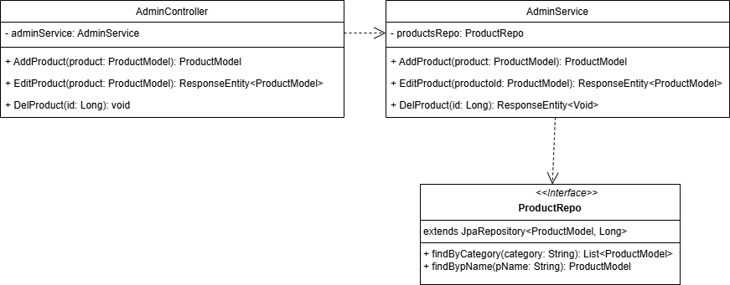

Slide 21
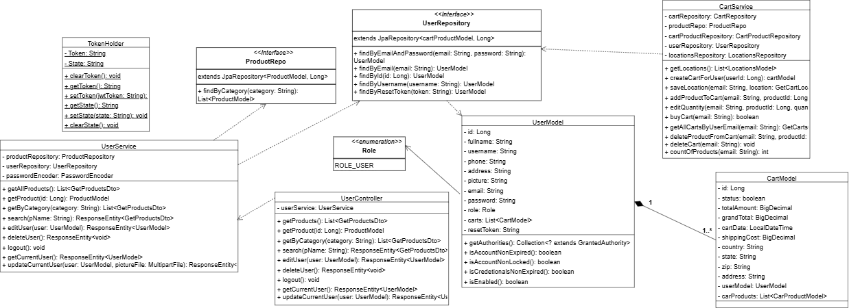

Slide 22
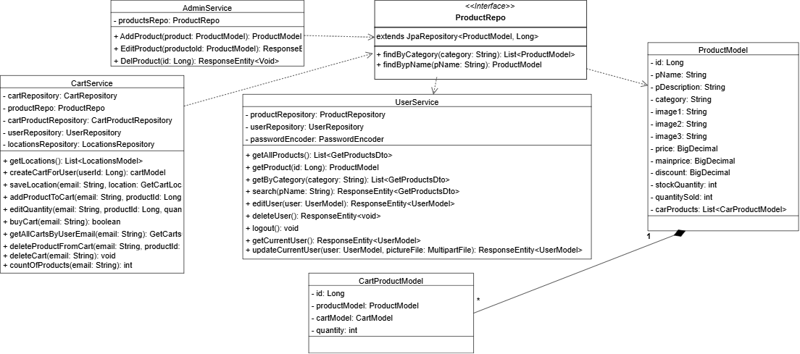

Slide 23
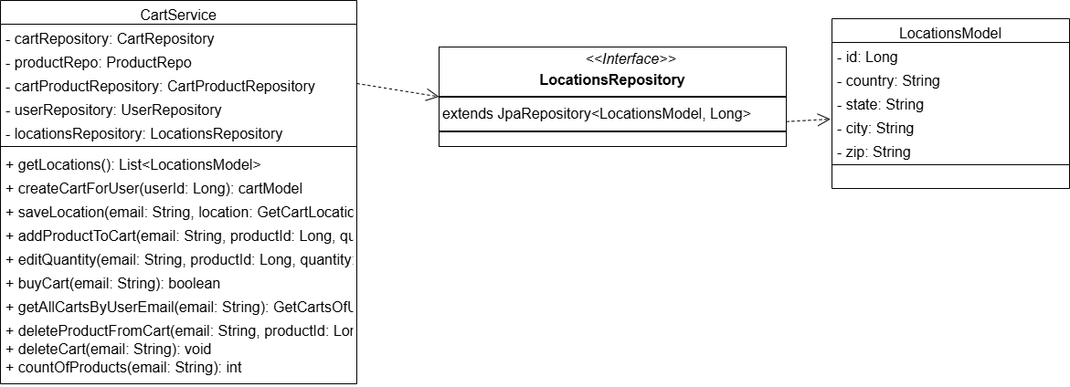

Slide 24
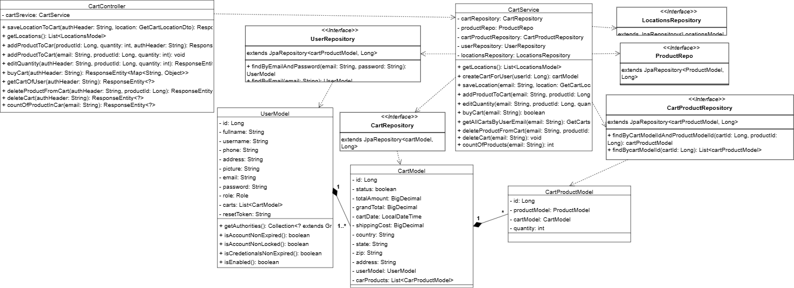

Slide 25
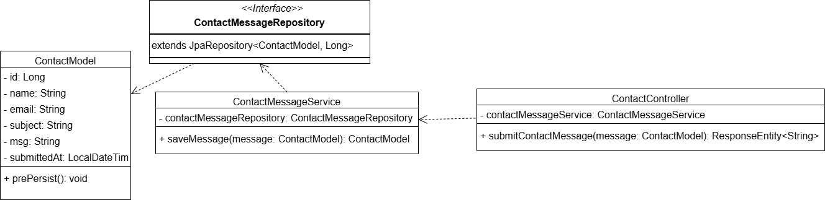

Slide 26
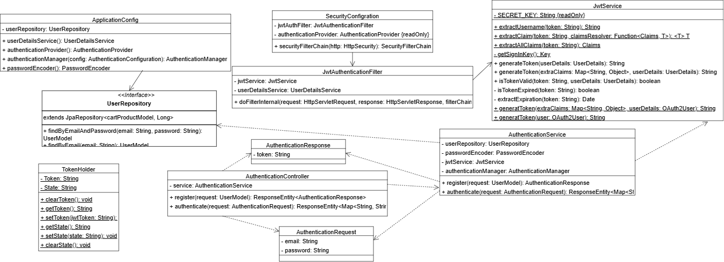

Slide 27
Entity Relationship Diagram (ERD)

Slide 28
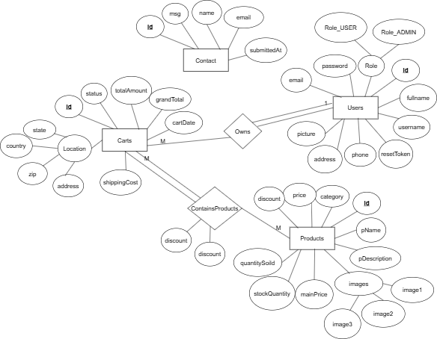

Slide 29
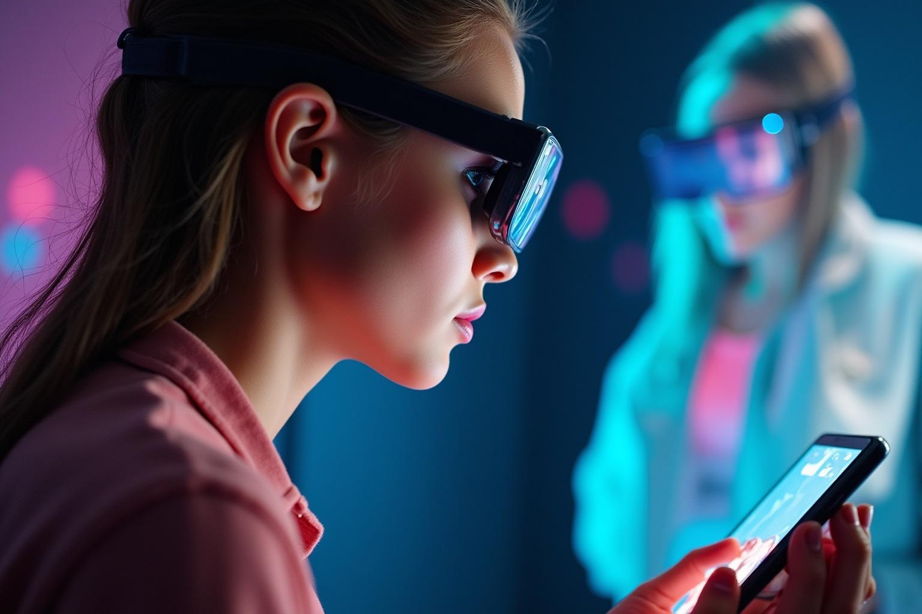
Virtual try-on technology allows customers to visualize how products would look on them through augmented reality or computer-generated imagery. This technology overlays a digital representation of a product onto a user's image using a webcam or mobile device camera, enhancing the online shopping experience by providing a more interactive and personalized approach.
Definition of Virtual Try-On

Slide 30
Importance in E-Commerce
The importance of virtual try-on in e-commerce lies in its ability to reduce return rates, increase customer satisfaction, and build consumer confidence. By allowing customers to see how items will fit or appear before making a purchase, businesses can enhance their engagement strategies, leading to higher conversion rates and customer loyalty.

Slide 31
Current Trends and Technologies
Current trends in virtual try-on technology include the integration of artificial intelligence and machine learning to improve personalization and accuracy in fitting. Additionally, the rise of mobile applications and AR technologies has made virtual try-ons more accessible to consumers. Companies are also leveraging 3D modeling to provide realistic representations of products, enhancing user engagement and encouraging conversions.

Slide 32
02
Implementation

Slide 33

Implementing virtual try-on technology requires robust technical infrastructure, including high-quality image processing capabilities, cloud storage for data management, and powerful frameworks. Businesses must consider compatibility with various devices and platforms to ensure an optimal user experience across smartphones, tablets, and computers. Security measures are also critical to protect user data and privacy.
Technical Requirements

Slide 34
User Experience Considerations
User experience is paramount when implementing virtual try-on solutions. It is essential to ensure a seamless and intuitive interface that allows easy navigation and use of the technology. Users should receive feedback on their interactions, such as fit suggestions or color options. Optimizing loading times and ensuring high-resolution graphics contribute significantly to customer satisfaction.

Slide 35
IDM-VTON
IDM-VTON is an advanced virtual try-on system that leverages diffusion models to create highly realistic clothing adaptations for users. Unlike traditional methods, IDM-VTON focuses on authentic garment fitting, ensuring that textures, folds, and proportions are preserved accurately.
.

Slide 36
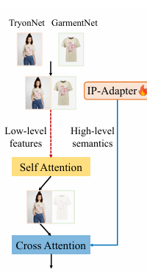
How it works
IDM-VTON is a virtual try-on system using diffusion models to generate realistic clothing adaptations. It gradually refines noise into high-quality images, ensuring garments fit naturally while preserving textures and folds. With advanced attention mechanisms, it enhances realism and integrates seamlessly with users’ photos.

Slide 37
VTON-HD
VITON-HD is a high-resolution virtual try-on system designed to improve the realism and accuracy of clothing adaptation in digital fashion applications. Unlike earlier models that generate low-resolution images, VITON-HD synthesizes 1024×768 virtual try-on images, ensuring sharper details and better garment alignment.

Slide 38
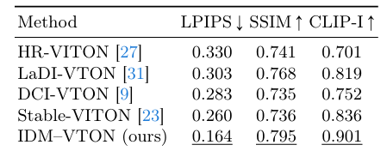
VTON-HD

Slide 39
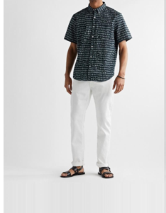
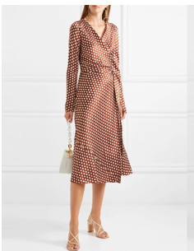
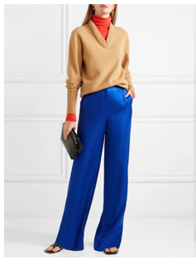
Fine-Tuning - Virtual Try-On Model
Our Contribution
Upper body
Dresses
Lower body

Slide 40
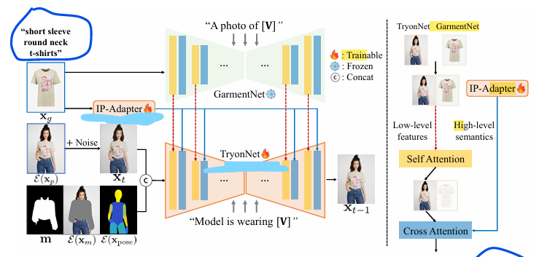
TryonNet (UNet) Architecture & Strategy
Why TryonNet (UNet) Fine-Tuning ?

Slide 41
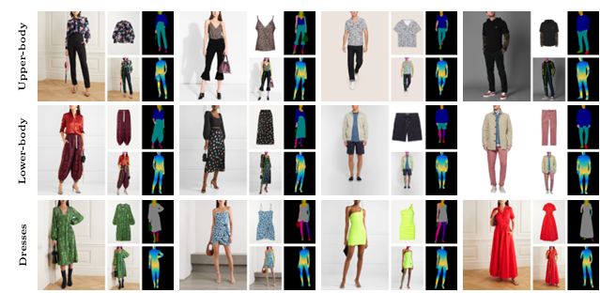
Training Strategy
DressCode dataset
53792 garments
3 categories
upper body
lower body
dresses
107584 images
1024 x 768 image resolution

Slide 42


Training Strategy
Dataset Approach
3,000 samples per category for training
35 samples per category for testing
14 epochs per category
Separate notebooks for each garment type

Slide 43
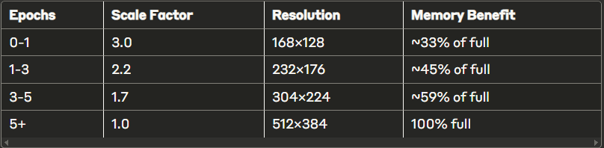
Training Strategy
Progressive Resolution Scaling
Memory Efficiency: Reduced VRAM requirements
Training Stability: Coarse-to-fine learning
Curriculum Learning: Gradually increasing difficulty
Faster Convergence: Quick structural learning first
Memory Optimization Techniques

Slide 44
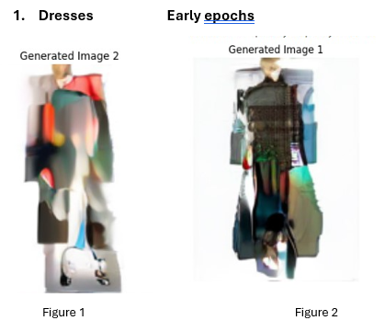
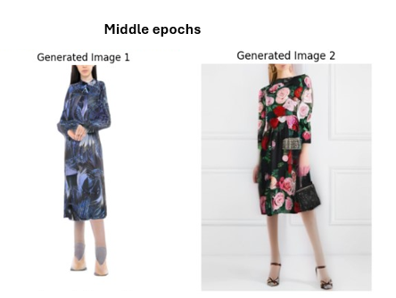
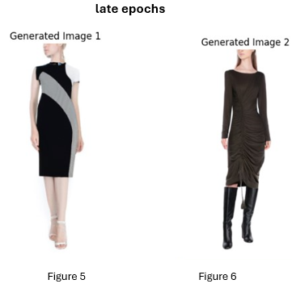
Training Progression Examples
Dresses
Early epochs
Middel epochs
Late epochs

Slide 45
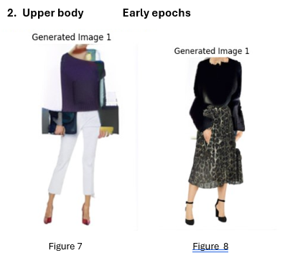
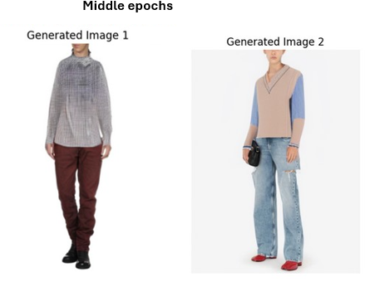
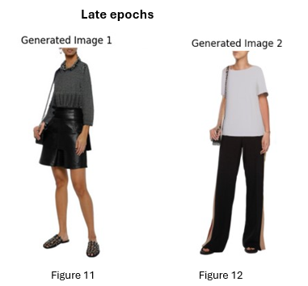
Training Progression Examples
Upper body
Early epochs
Middel epochs
Late epochs

Slide 46
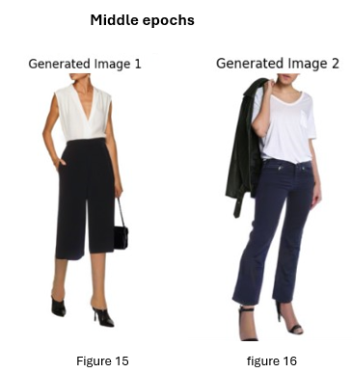
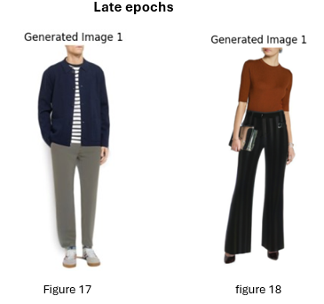
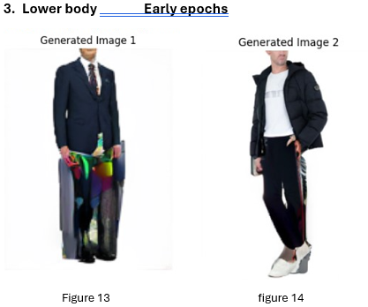
Training Progression Examples
Lower body
Late epochs
Early epochs
Middel epochs

Slide 47
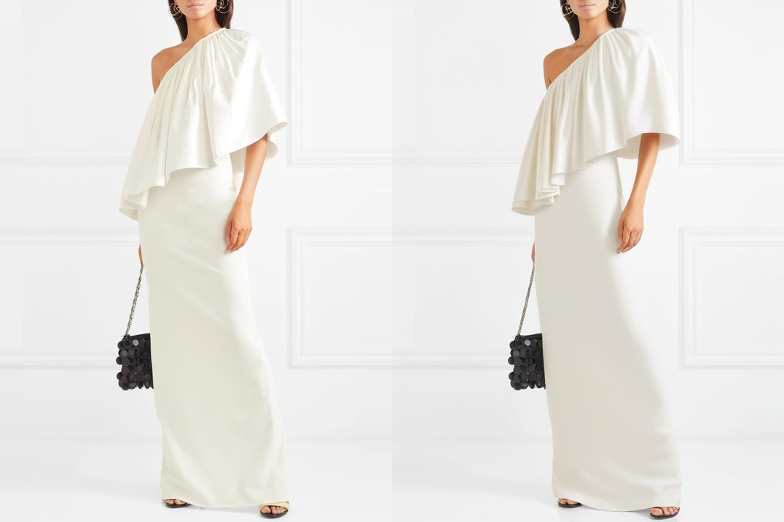
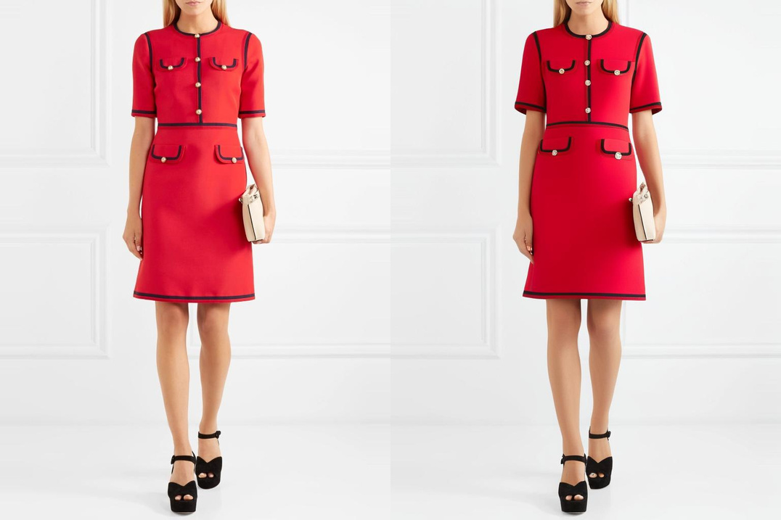
Results & Performance
Dresses

Slide 48
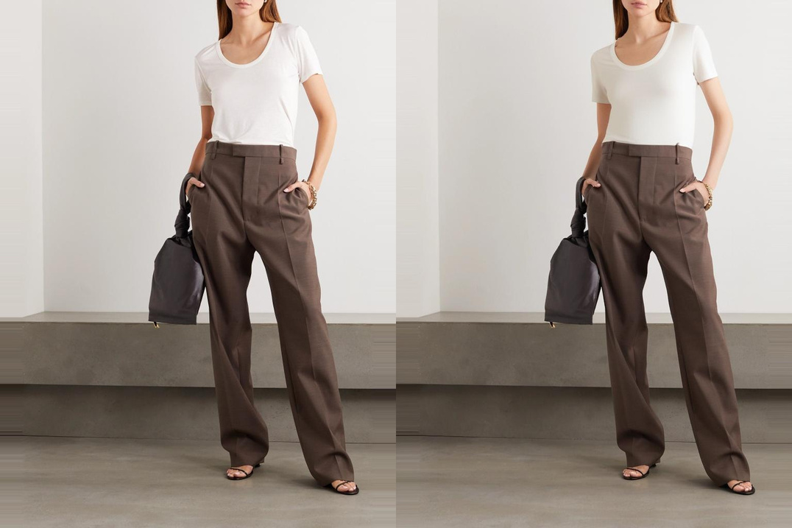
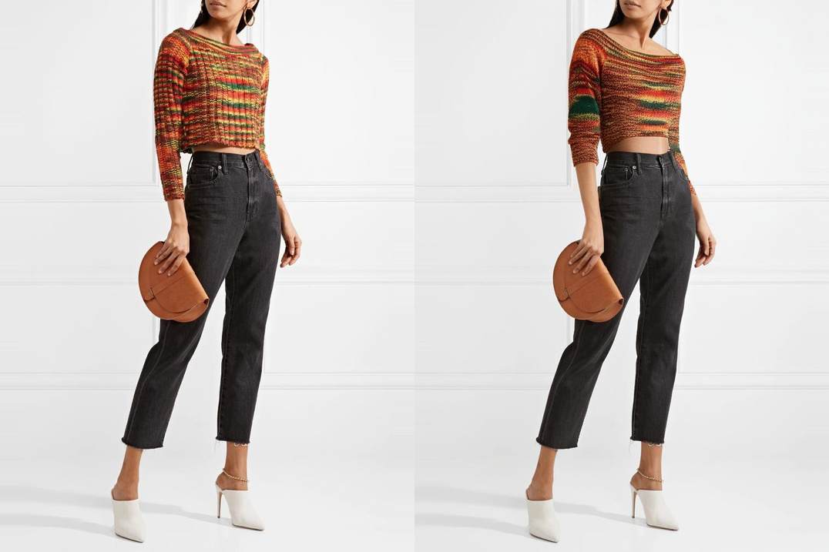
Results & Performance
Upper body

Slide 49
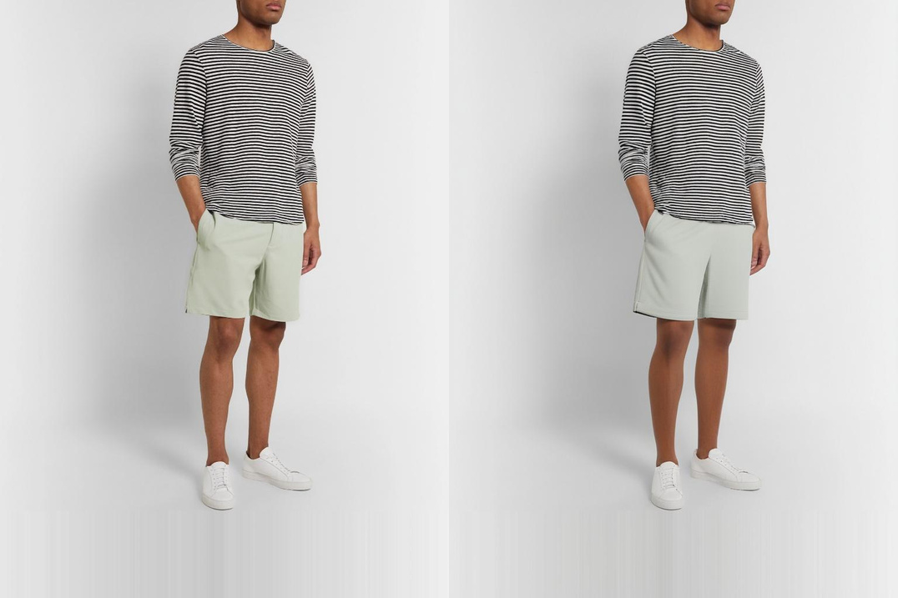
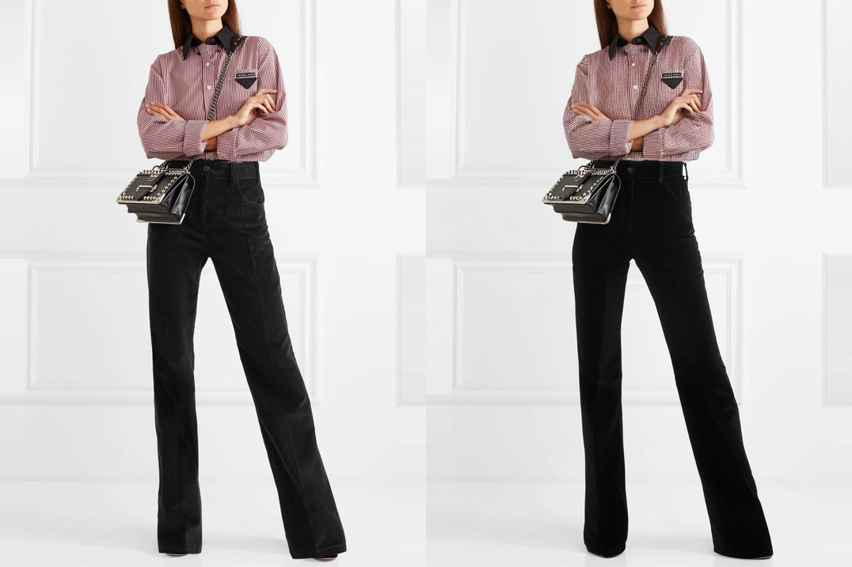
Results & Performance
Lower body

Slide 50
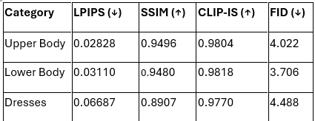
Results & Performance
Legend:
↓ = Lower is better
↑ = Higher is better

Slide 51

Challenges & Solutions
Hardware Constraints
Dataset Challenges

Slide 52


Key Takeaways
What We Achieved ?
✅ Successfully extended single-category model
to multi-category
✅ Maintained high visual quality
across all garment types
✅ Developed memory-efficient
training approach

Slide 53

Future Improvements
Higher resolution training (when more memory available)
Additional garment categories

Slide 54
Challenges and Solutions
The implementation of virtual try-on technology faces several challenges, including the need for accurate modeling and rendering of products. Additionally, users may encounter technical issues such as lagging or inaccurate overlays. Solutions include investing in high-quality imaging technology, improving algorithms for better accuracy, and providing comprehensive user support to address issues promptly.

Slide 55
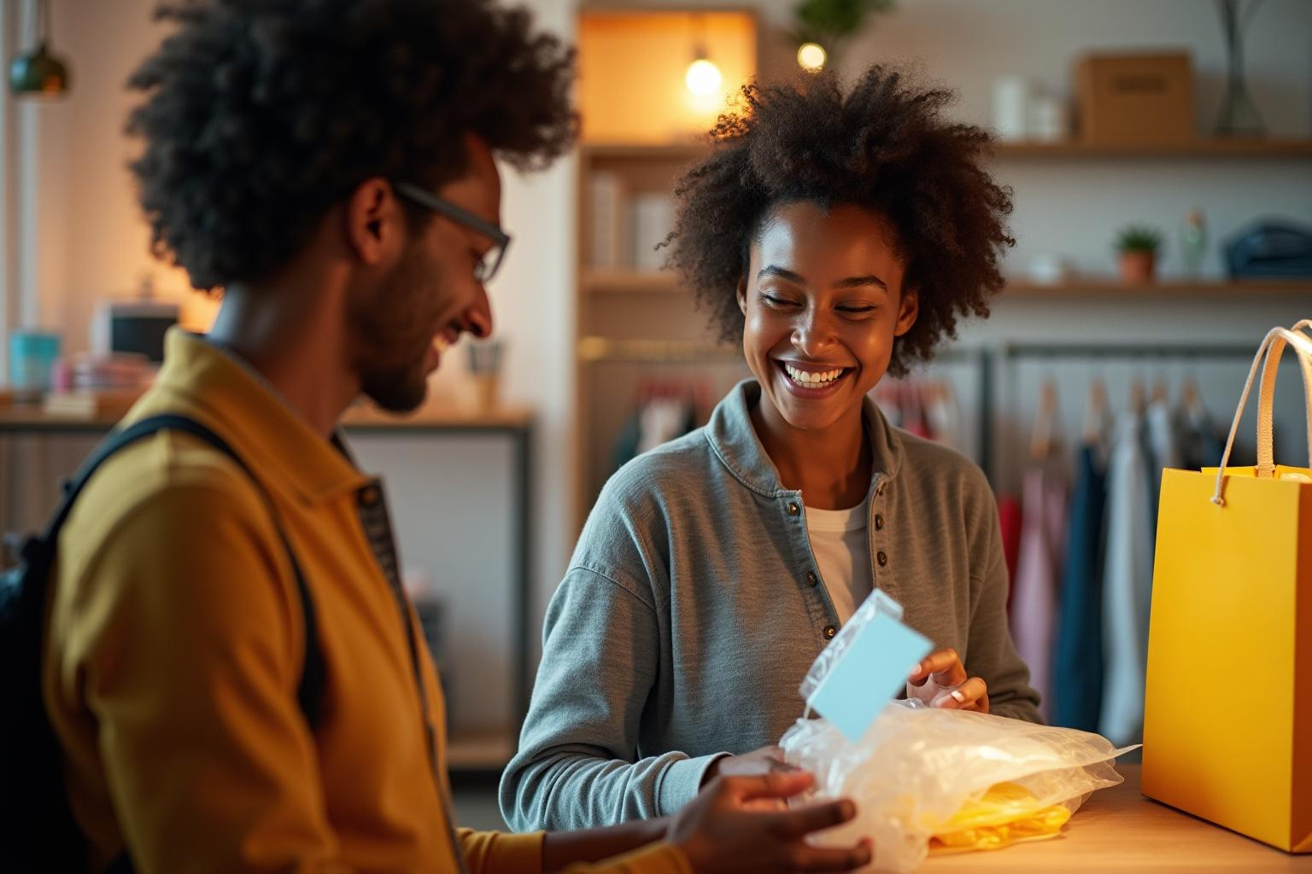
Virtual try-on technology is revolutionizing the e-commerce landscape by enhancing customer engagement and reducing return rates. By understanding and addressing technical requirements, user experience considerations, and potential challenges, businesses can successfully implement this innovative solution to gain a competitive edge in the market.
Conclusions

Slide 56



Thank you!
Do you have any questions?
Try & Buy Team || FCAI – Helwan University
Computer Science Department || Graduation Project 2025

